Slide 1
Weekly Report
2024년 10월 28일
Su-Hak Lee, Hee-Ju Yeo
Department of Computer Engineering

Slide 2
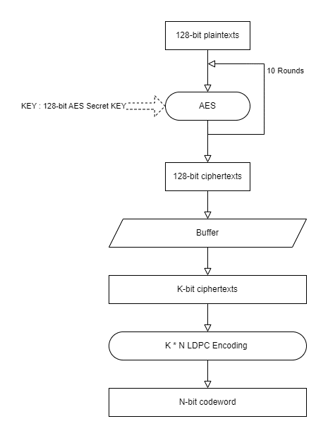
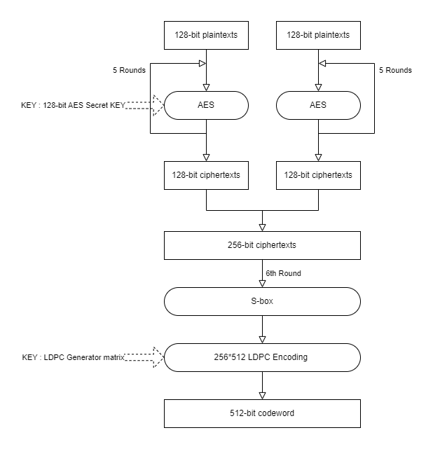
Cryptcoding
AES & LDPC
LDPC-ECC

Slide 3
GOAL
Specification for the Advanced Encryption Standard(AES)
→ Diffusion
LDPC-ECC, JSALC 행렬 연산 과정 정리

